Slide 1
Course: Professional Practices
Lecture # 2

Slide 2
Agenda
Introduction of Professional practices.
Rights. Negative vs positive rights.
Legal Rights vs Moral rights
Character, morals, personality, culture, self identity,
Case Study: Managing Oneself

Slide 3
Legal/Illegal
Moral/Immoral

Slide 4
Rights
What are rights?
Examples:
“You have no right to tell me what to do”
“ I have the right to do that”

Slide 5
Categorizing Rights
Philosophers often make an important distinction in the nature and type of (how to consider) rights as:
Negative Rights
Positive Rights

Slide 6
Negative Rights
Negative rights are those rights which require restraint by others.
Examples:
My right of not to be killed, robbed, poisoned, harmed and so on. It requires others refrain from killing, robbing, poisoning me…….
However negative rights does not require that others take action to keep me alive, putting locks and guards to save me from being robbed …………..

Slide 7
Positive Rights
Positive rights are those which implies others have a duty towards the right holder.
Example:
If I have a right to live then not only others have to refrain from killing me but also they need to feed me, keep me safe etc.

Slide 8
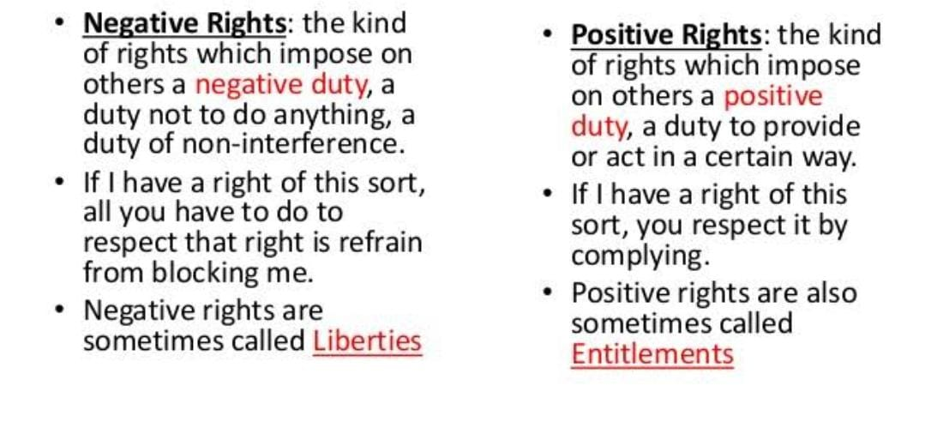

Slide 9
Further classes of Rights
Legal Rights
Moral Rights

Slide 10
Legal Rights
Legal rights are rights created and applied by the law. The law enforces a statement or code of conduct, a deed to be done or rule to follow and fixes a punishment against violating the law.

Slide 11
Moral Rights
Moral , natural or human rights are independent from the law.
A civilized society’s first line of defense is not the law, police and courts but customs, traditions and moral values. Behavioral norms, mostly transmitted by example, word of mouth and religious teachings, represent a body of wisdom distilled over the ages through experience and trial and error.

Slide 12
Moral vs Legal
Moral status leads to let you decide on the base of good or bad consciousness, religious training, manners etc. Although it does not involve penalty in violating such rights but a feeling of guilt is always there too follow.
Legal status enforces your deeds on the grounds of defined law and has a penalty or punishment for those violating such rights or laws.

Slide 13
Case 1 (Polluting the environment)
Moral status
Don’t throw waste papers on the ground it will pollute the environment
Legal status
Making the case legal how????

Slide 14
Case 2 (Oldies get a seat in a loaded bus)
Moral Status
Youngers should give the oldies a seat ; good manners
Legal Status
Label some seats for the oldies and fine those youngsters who don’t give away the seats for the oldies

Slide 15
Case 3 (Password privacy in an organization)
Moral status
No one is supposed to share their password else their data can be tampered, stolen etc..
Legal status
If any one leaks his/her password he/she should pay a fine and suspended for a day.

Slide 16
Case 4 (An institute giving degrees to those who are not eligible vs giving degrees which are not recognized)
Moral status
No one is supposed to give degrees unless the requirements are fulfilled. Low standards of required skill are against moral values.
Legal status
If some one provides degrees which are not recognized by any higher commission or whose charter is not valid.

